Slide 1

School of Electrical Engineering and Computer Science
Department of Electrical Engineering
EE-371 : Control Systems
Lecture#16,17
Reduction of Multiple Sub-Systems
Textbook: Chapter # 05 (5th edition)
Text Book: Control Systems Engineering by Norman S. Nise 5th Edition
Instructor: Ms Neelma Naz
Class: BEE 12 C/D

Slide 2
Reduction of Multiple Sub-Systems
Textbook: Chapter # 05 (5th edition)

Slide 3
Introduction
Subsystems represented by a block with its input and output.
We have learned how to find response of the subsystem.
Complicated systems are represented by the interconnection of subsystems.
We want to find response of the entire system. ?????
Represent the interconnected multiple subsystems as a single transfer function
Apply the analytical techniques, we lave learned for analyzing a subsystem, and obtain response information about the entire system.

Slide 4
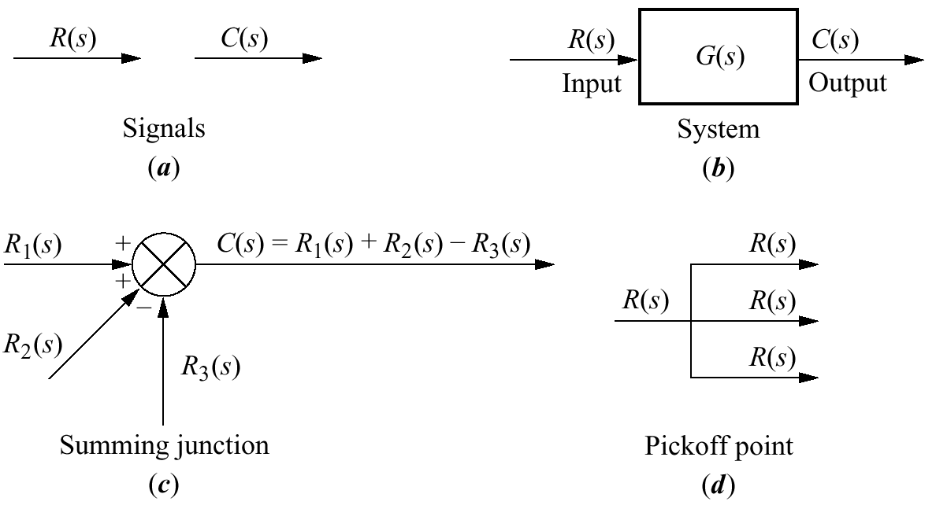
Components of a block diagram for a linear, time-invariant system

Slide 5
Common Topologies for Interconnecting Subsystems

Slide 6
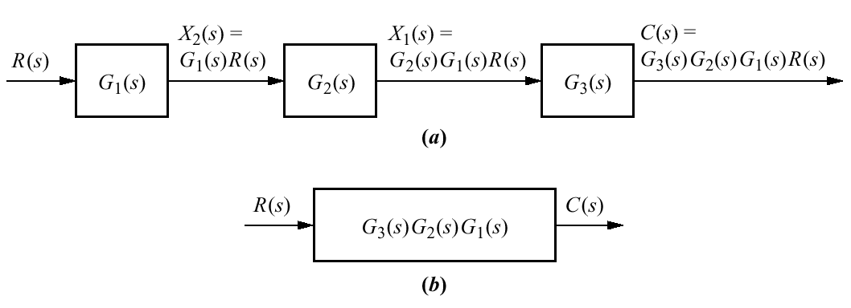
Cascade Form
Equivalent transfer function

Slide 7
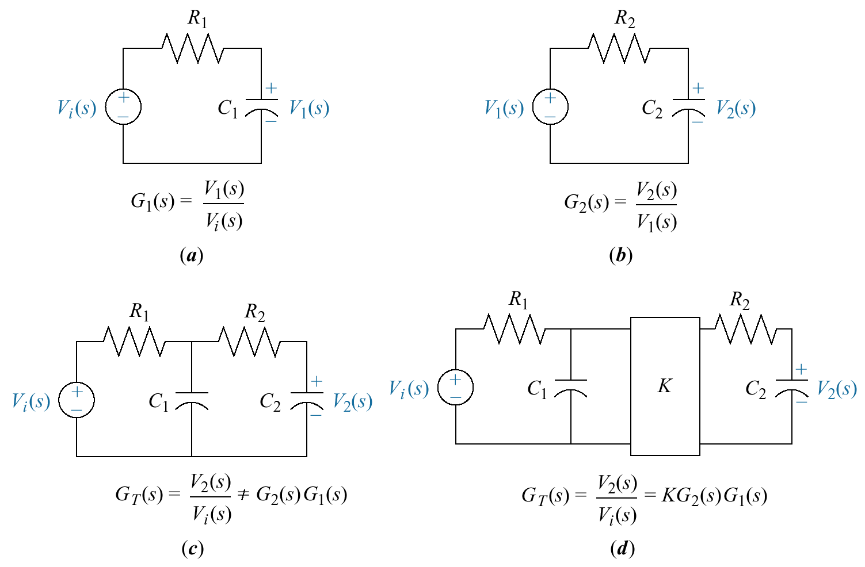
Loading in cascaded systems

Slide 8
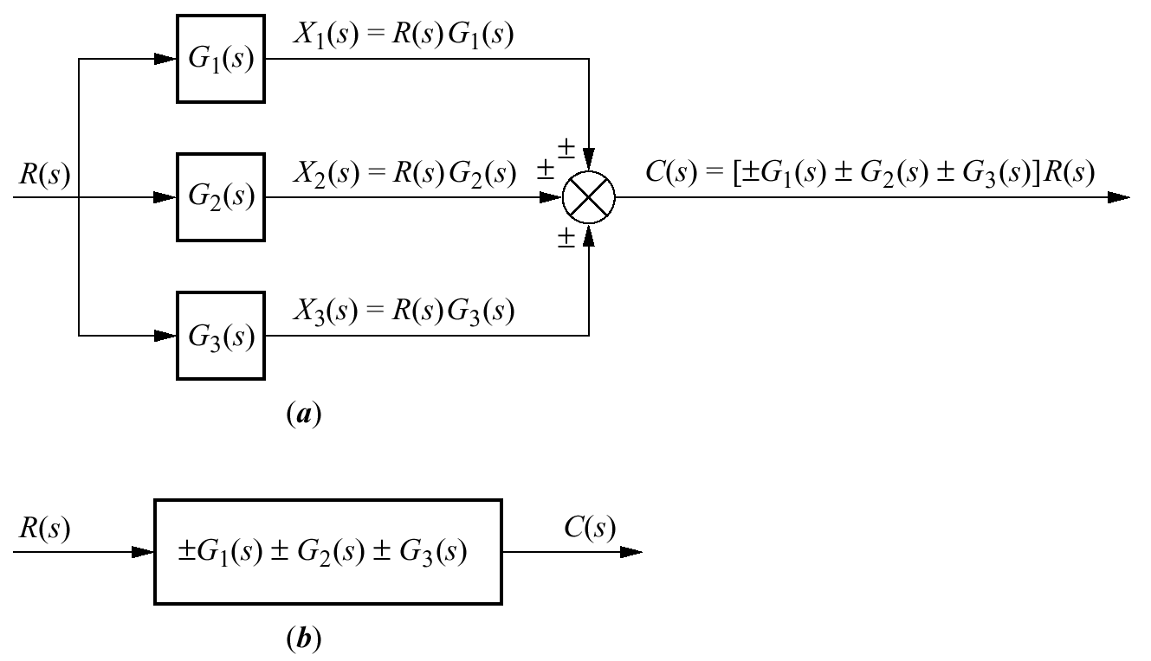
Parallel Form
Equivalent transfer function

Slide 9
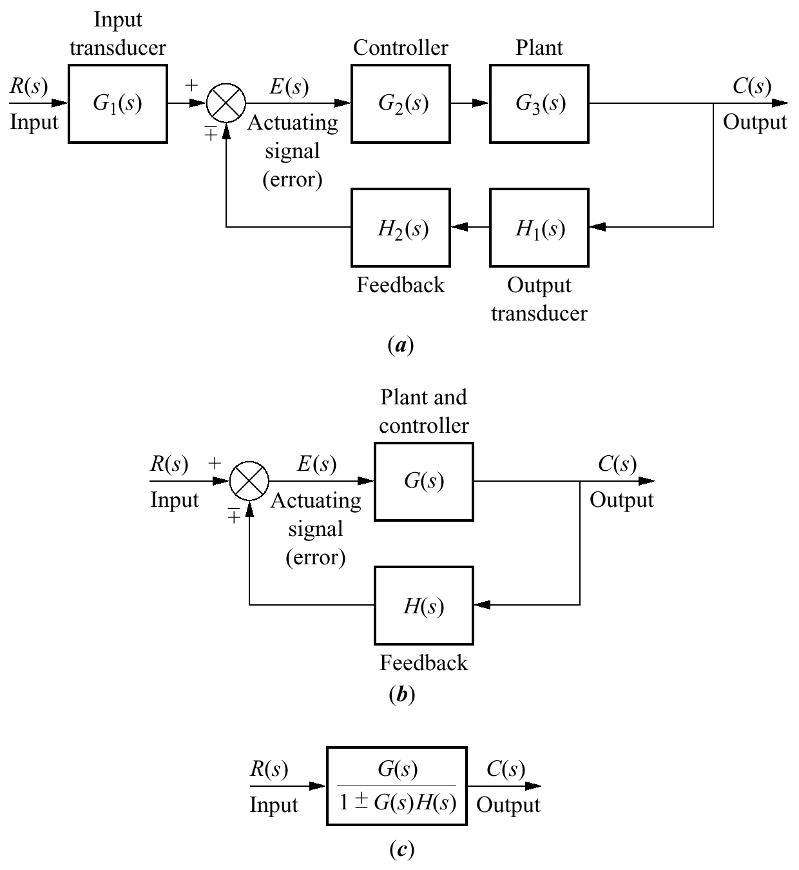



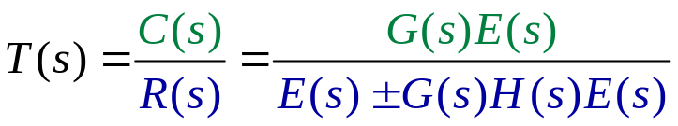
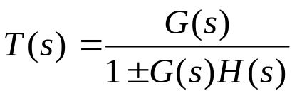
Feedback Form
Equivalent transfer function
Simplified model

Slide 10
Block diagram algebra

Slide 11
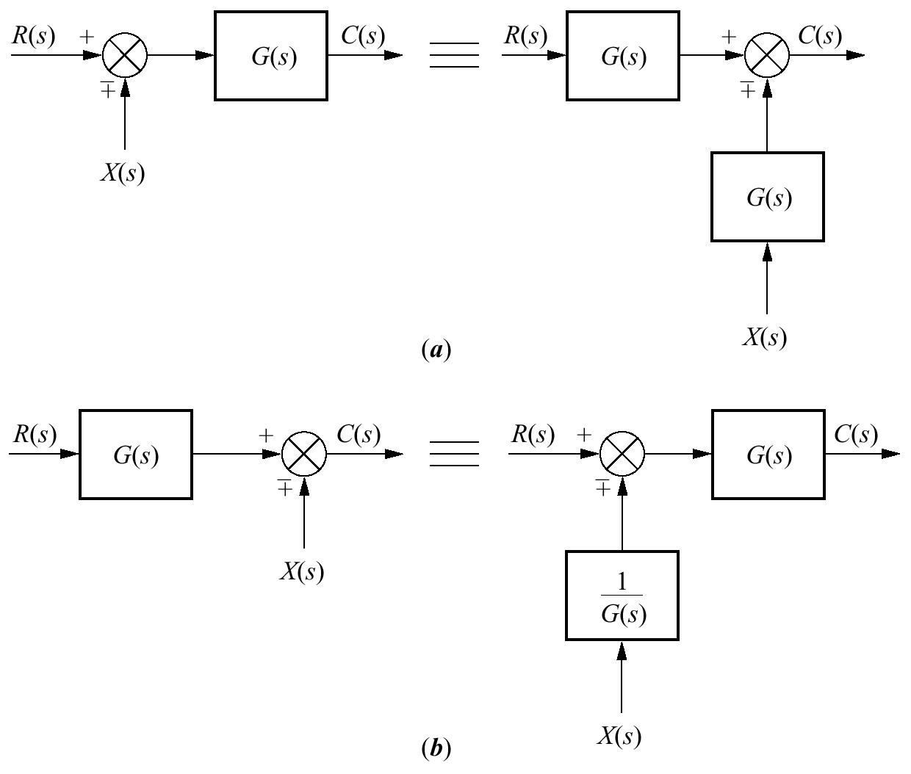
Block diagram algebra for summing junctions
Equivalent forms for moving a block
a. To the left past a
summing junction
b. To the right past a
summing junction

Slide 12
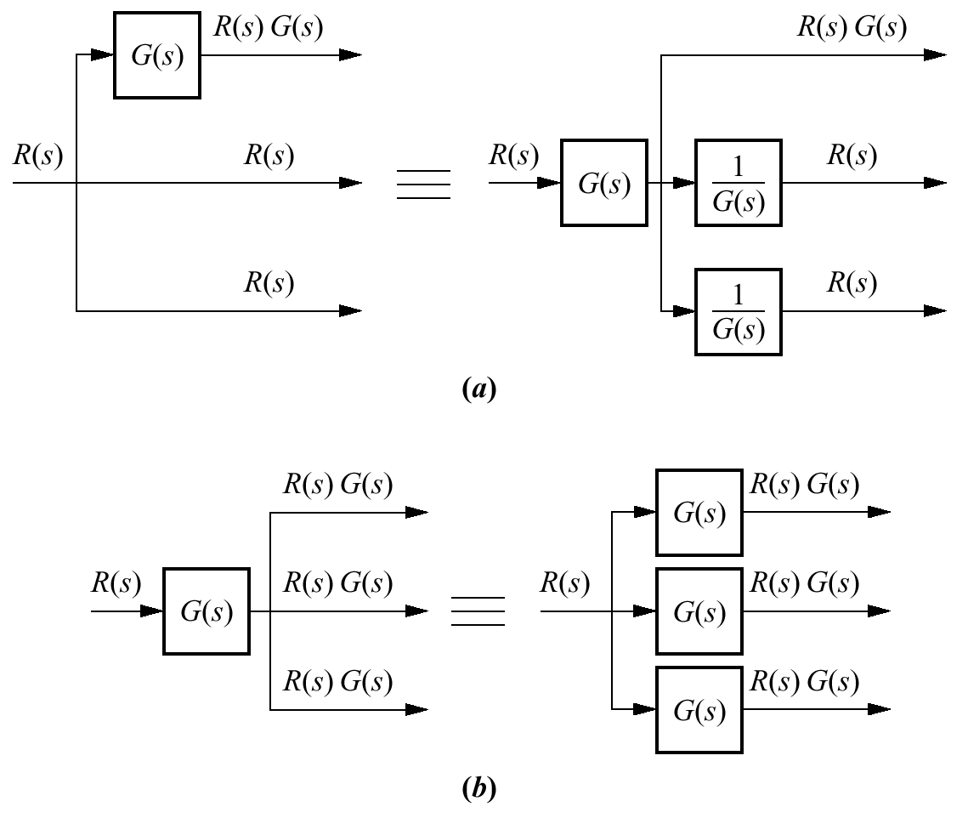
Block diagram algebra for pickoff points
Equivalent forms for moving a block
a. To the left past a pickoff point
b. To the right past a pickoff point

Slide 13
Examples

Slide 14
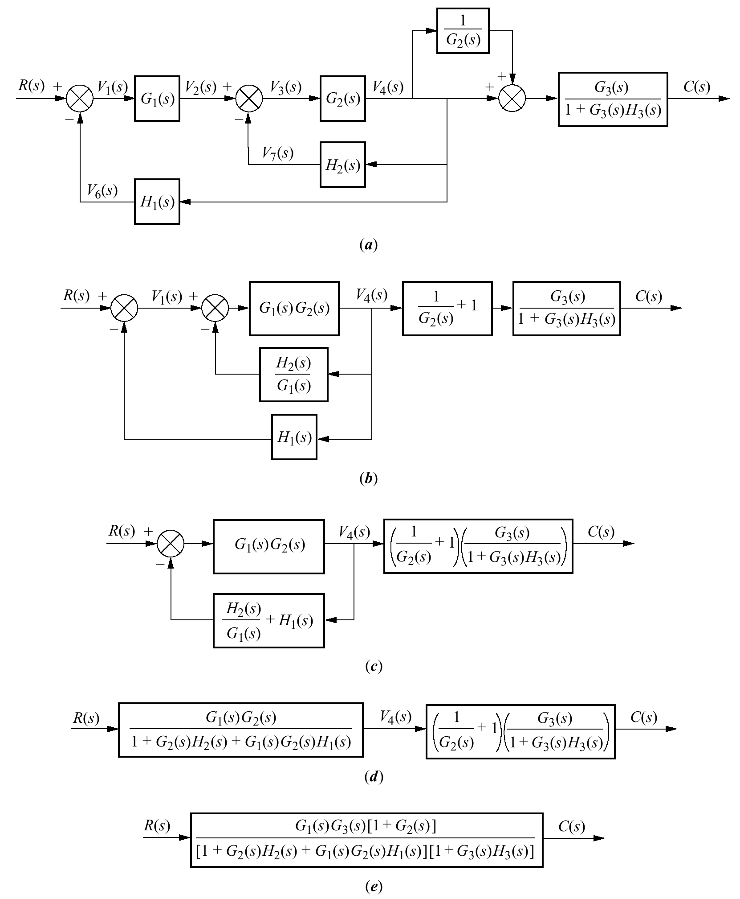
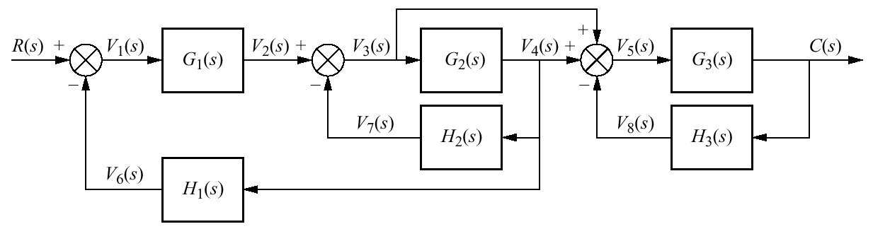
Example 5.2
PROBLEM: Reduce the system shown in the Figure to a single transfer function.

Slide 15
Example 5.2
(Solution)

Slide 16
Example 5.2
(Solution)

Slide 17
Home Assignment
Exercise 5.1
Problems: 1, 2, 3, 4, 5, 6
-------------------------------------
Exercise 5.1 & Problems: 1,4 Do submit

Slide 18
Analysis and Design of Feedback Systems

Slide 19
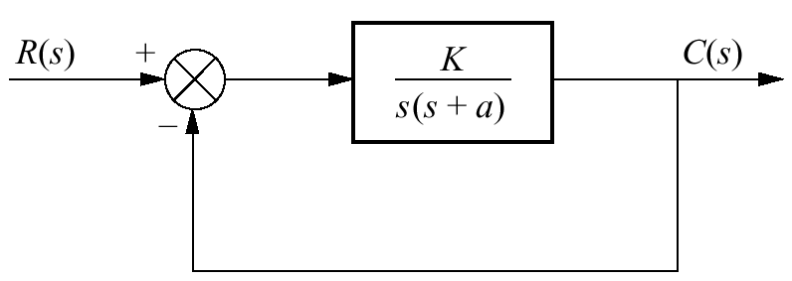
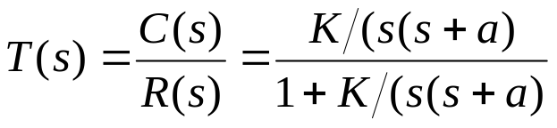
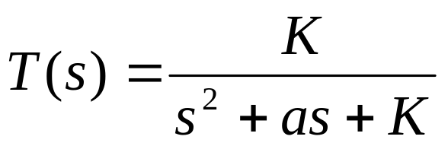
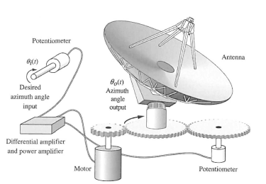
Analysis and Design of
Feedback Systems
As K varies, the poles move through the three ranges of operation of a
second-order system:
overdamped
critically damped
underdamped

Slide 20
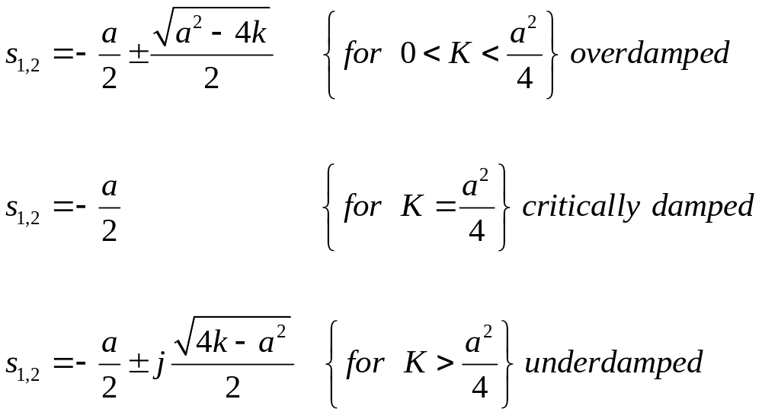

Slide 21
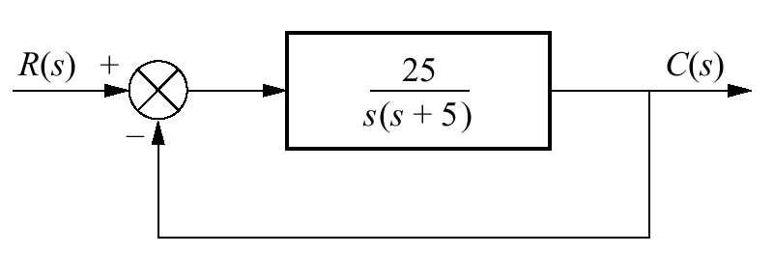
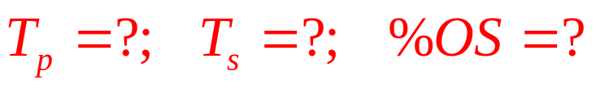
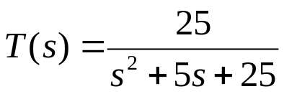
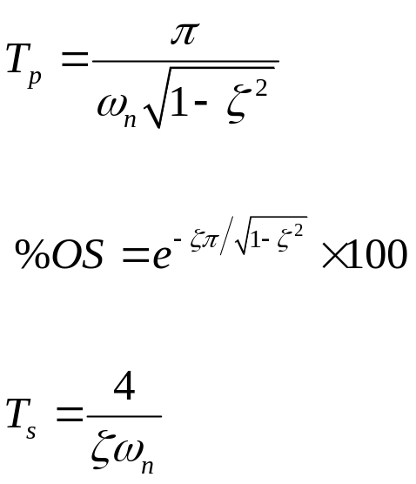
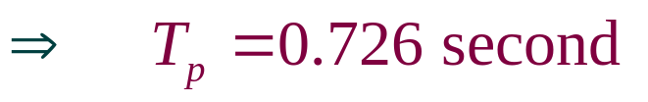



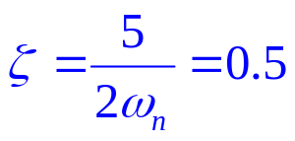

Example 5.3
Finding Transient Response
PROBLEM: For the system shown in the Figure, find the peak time, percent overshoot, and settling time.
Solution

Slide 22
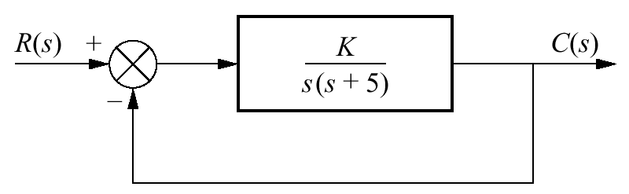
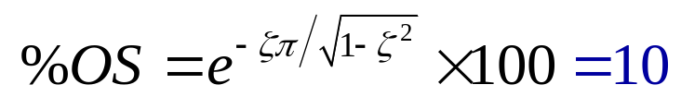
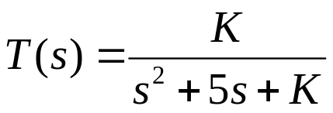
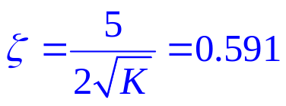



Example 5.4
Gain Design for Transient Response
PRO BLEM: Design the value of gain K for the feedback control system, so that the system will respond with a 10% overshoot.
Solution

Slide 23
Signal-Flow Graphs

Slide 24
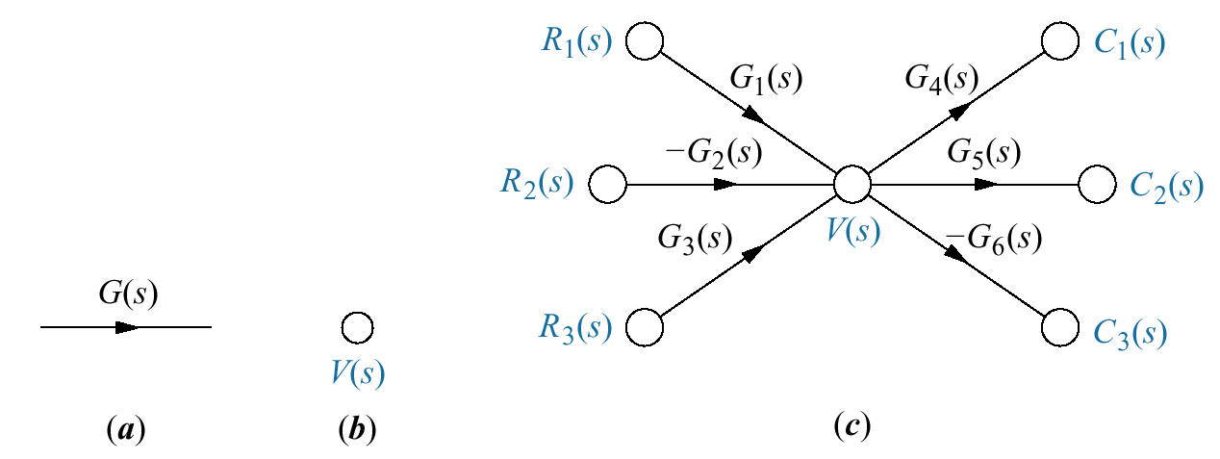
Signal-Flow Graphs
Signal-flow graphs are an alternative to block diagrams.
Block diagrams consist of blocks, signals, summing junctions, and pickoff points.
A signal-flow graph consists of branches, which represent systems, and nodes, which represent signals.

Slide 25
Signal-flow graph components:
a. systems
b. signals
and
c. interconnection of systems and signals
V(s) = R₁(s)G₁(s) - R₂(s)G₂(s) + R₃(s)G₃(s)
The signal C₁(s) = V(s)G₄(s)
The signal C₂(s) = V(s)G₅(s)
The signal C₃(s) = -V(s)G₆(s)
NOTE:
The negative sign is associated with the system and not with a summing junction

Slide 26
Converting Common Block Diagrams to Signal-Flow Graphs
Example 5.5

Slide 27
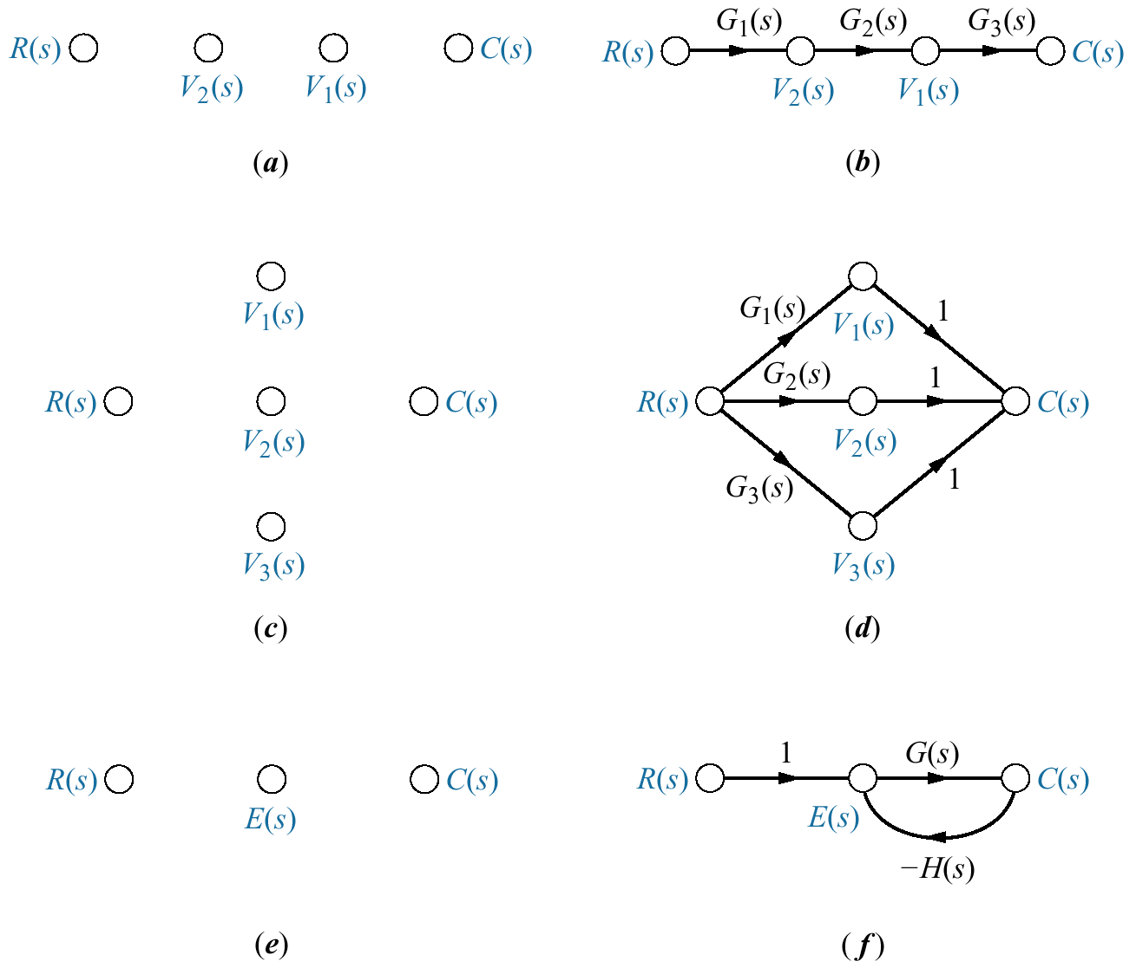
Cascaded subsystems
V₂(s)=
V₁(s)=

Slide 28



Parallel subsystems

Slide 29

Feedback control system

Slide 30
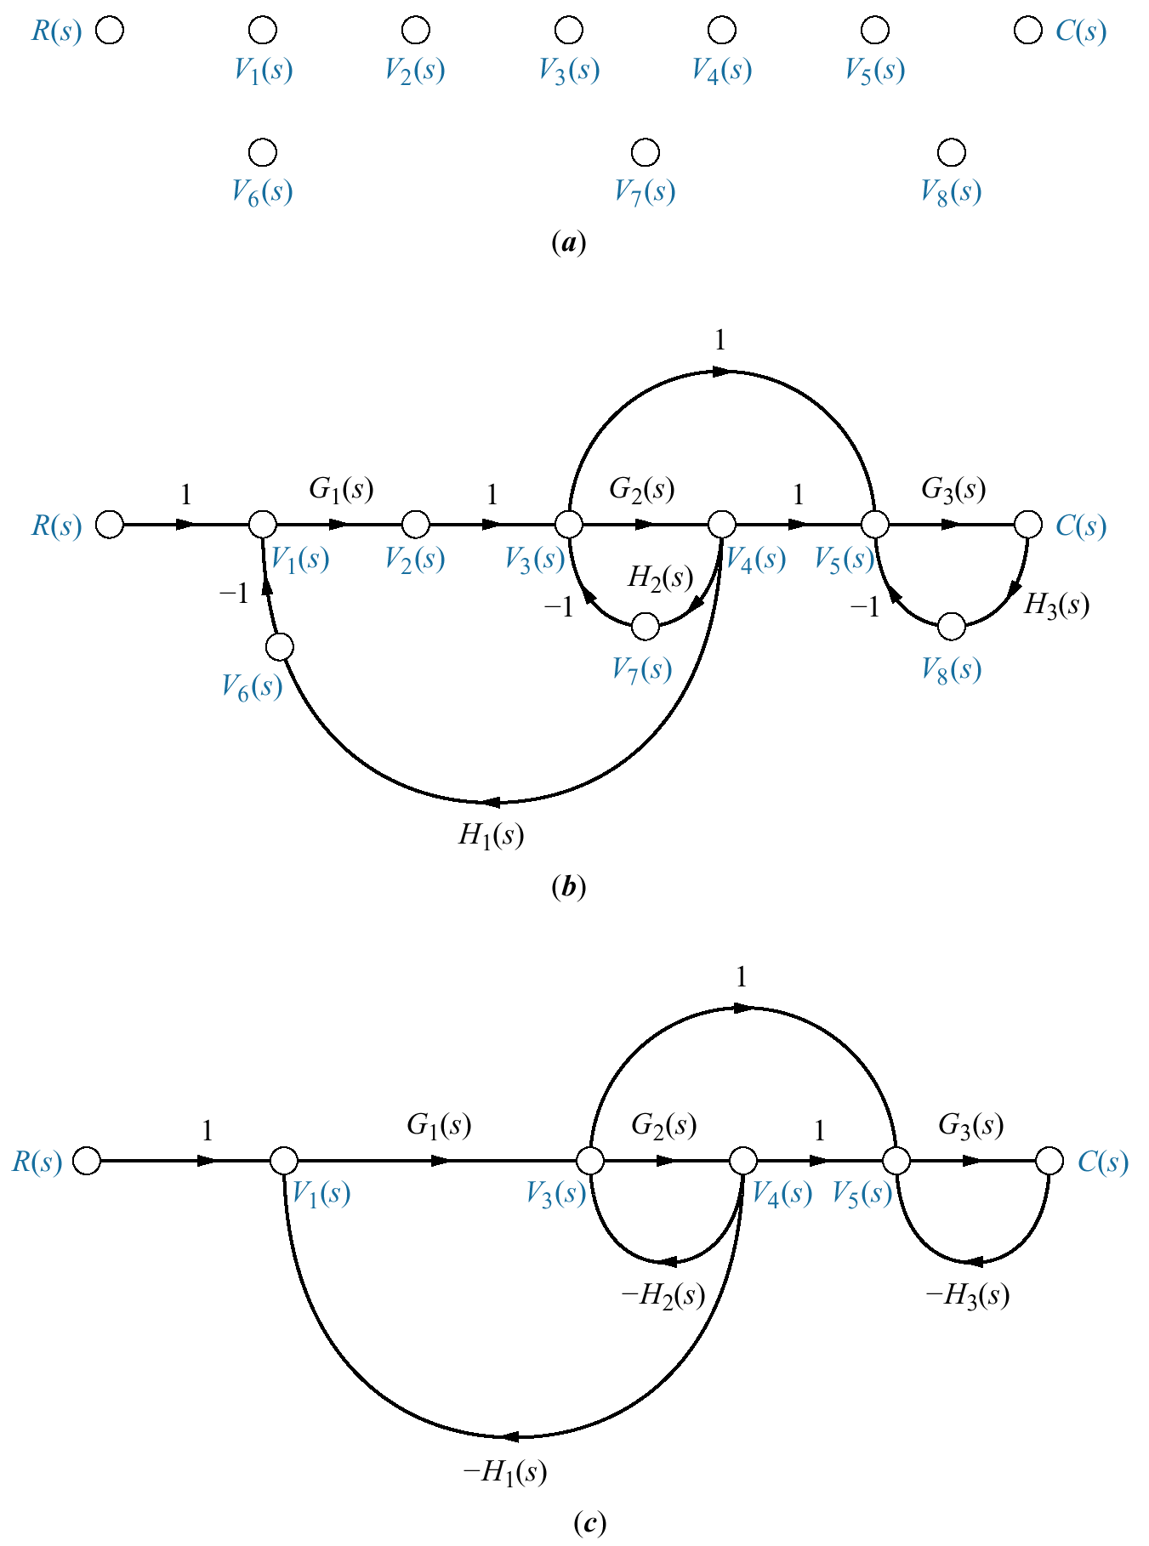
Example 5.6
Converting a Block Diagram to a Signal-Flow Graph
Block diagram Example 5.2

Slide 31
Signal-flow graph development

Slide 32
Simplification of signal-flow graph
signal nodes
signal-flow graph
simplified signal-flow graph

Slide 33
Mason's Rule
(Self Study)

Slide 34
Mason's rule for reducing a signal-flow graph to a single transfer function requires the application of one formula.
The formula was derived by S. J. Mason when he related the signal-flow graph to the simultaneous equations that can be written from the graph (Mason, 1953)

Slide 35
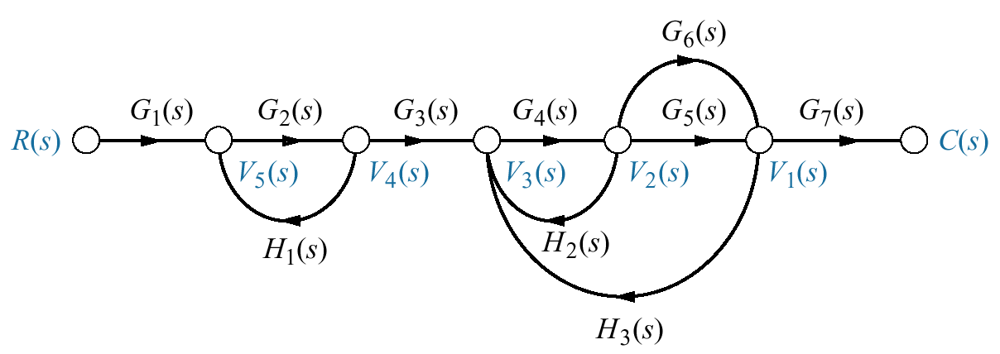
Definitions
Loop gain. Product of branch gains found by traversing a path that starts at a node and ends at the same node, following the direction of the signal flow
How may loops ???
1. G₂(s)H₁(s)
2. G₄(s)H₂(s)
3. G₄(s)G₅(s)H₃(s)
4. G₄(s)G₆(s)H₃(s)

Slide 36
Forward-path gain. The product of gains found by traversing a path from the input node to the output node of the signal-flow graph in the direction of signal flow
How may forward paths ???
1. G₁(s)G₂(s)G₃(s)G₄(s)G₅(s)G₇(s)
2. G₁(s)G₂(s)G₃(s)G₄(s)G₆(s)G₇(s)

Slide 37
Nontouching loops.
Loops that do not have any node in common
How may nontouching loops ???
loop G₂(s)H₁(s) does not touch
loops G₄(s)H₂(s), G₄(s)G₅(s)H₃(s), and G₄(s)G₆(s)H₃(s).
3 nontouching loops

Slide 38
Nontouching loops gain
The product of loop gains from nontouching loops taken two, three, four, or more at a time
Nontouching-loop gains taken two at a time :
In our example three nontouching loops do not exist
No nontouching-loop gains taken three at a time since.
1. [G₂(s)H₁(s)] [G₄(s)H₂(s)]
2. [G₂(s)H₁(s)] [G₄(s)G₅(s)H₃(s)]
3. [G₂(s)H₁(s)] [G₄(s)G₆(s)H₃(s)]

Slide 39

Mason's Rule
The transfer function, C(s)/R(s), of a system represented by a signal-flow graph is
k = number of forward paths
T_{k} = the kth forward-path gain
∆ = 1 - ∑ loop gains + ∑ nontouching-loop gains taken 2 at a time
- ∑ NTLG taken 3 at a time + ∑ NTLG taken 4 at a time — ...
∆ _{k} = ∆ - ∑ loop gain terms in ∆ that touch the kth forward path.
(∆ _{k} is formed by eliminating from ∆
those loop gains that touch the kth forward path)

Slide 40
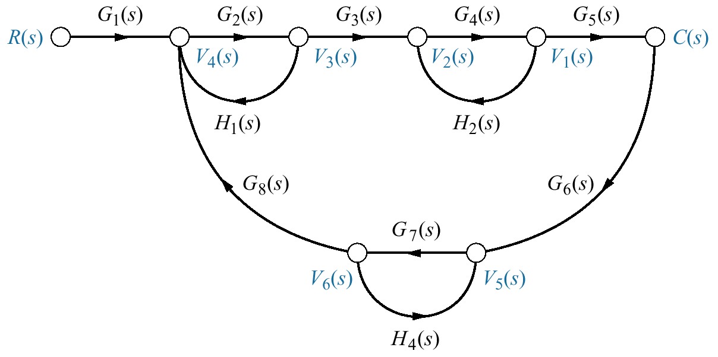
Example 5.7
Transfer Function via Mason's Rule
PROBLEM: Find the transfer function, C(s)/R(s) for the signal-flow graph .

Slide 41
Example 5.7
Transfer Function via Mason's Rule
1. Identify the forward-path gains
G₁(s)G₂(s)G₃(s)G₄(s)G₅(s)
2. Identify the loop gains
1. G₂(s)H₁(s)
2. G₄(s)H₂(s)
3. G₇(s)H₄(s)
4. G₂(s)G₃(s)G₄(s)G₅(s) G₆(s) G₇(s) G₈(s)
3. Identify the nontouching loops taken two at a time.
Loop 1 and loop 2 : [G₂(s)H₁(s)][G₄(s)H₂(s)]
Loop l and loop 3 : [G₂(s)H₁(s)][G₇(s)H₄(s)]
Loop 2 and loop 3 : [G₄(s)H₂(s)][G₇(s)H₄(s)]

Slide 42
Example 5.7
Transfer Function via Mason's Rule
3. Identify the nontouching loops taken three at a time.
Loop 1 and loop 2 and 3 : [G₂(s)H₁(s)][G₄(s)H₂(s)] [G₇(s)H₄(s)]
∆ = 1 - ∑ loop gains + ∑ nontouching-loop gains taken 2 at a time - ∑ NTLG taken 3 at a time
∆ = 1 – [G₂(s)H₁(s) + G₄(s)H₂(s) + G₇(s)H₄(s)+ G₂(s)G₃(s)G₄(s)G₅(s) G₆(s) G₇(s) G₈(s)]
+ [G₂(s)H₁(s)G₄(s)H₂(s)+ G₂(s)H₁(s)G₇(s)H₄(s)+ G₄(s)H₂(s)G₇(s)H₄(s)]
- [G₂(s)H₁(s)G₄(s)H₂(s)G₇(s)H₄(s)]

Slide 43


∆ = 1 – [G₂(s)H₁(s) + G₄(s)H₂(s) + G₇(s)H₄(s)+ G₂(s)G₃(s)G₄(s)G₅(s) G₆(s) G₇(s) G₈(s)]
+ [G₂(s)H₁(s)G₄(s)H₂(s)+ G₂(s)H₁(s)G₇(s)H₄(s)+ G₄(s)H₂(s)G₇(s)H₄(s)]
- [G₂(s)H₁(s)G₄(s)H₂(s)G₇(s)H₄(s)]

Slide 44
Stability
Textbook: Chapter # 06 (5th edition)
Text Book: Control Systems Engineering by Norman S. Nise 5th Edition
6.1 Introduction

Slide 45
Introduction
Control systems analysis and design focus on three specifications:
transient response
stability
steady-state errors

Slide 46
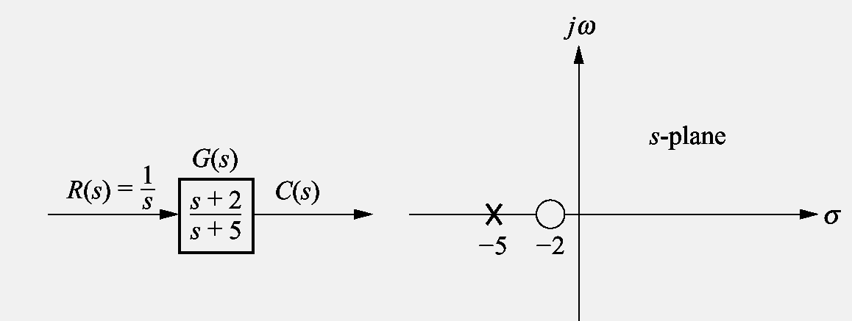
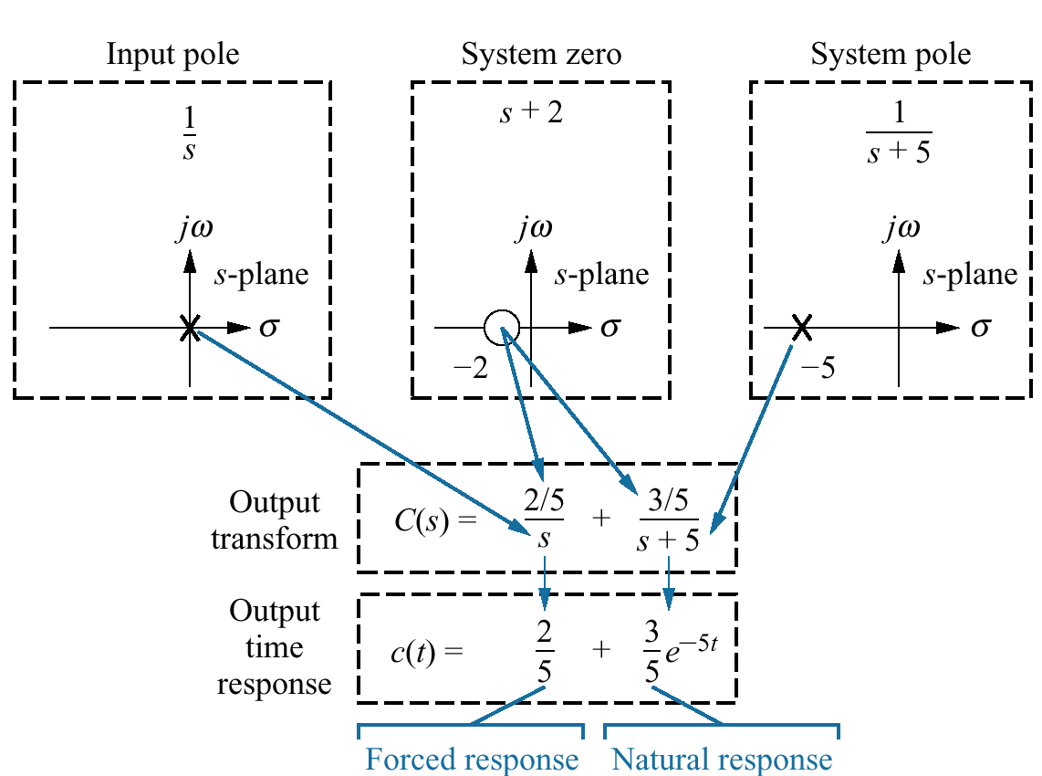
We can control the output of a system
if
the steady-state response consists of
only the forced response
The system is stable
The total response of a system is sum of the forced and natural responses
c(t) = c_{forced}(t) + c_{natural}(t)
Transient and steady state responses of a system can be controlled only if the system is stable

Slide 47
Definitions
(from natural response perspective )
Stability : A linear, time-invariant system is stable if the natural response approaches zero as time approaches infinity.
Instability : A linear, time-invariant system is unstable if the natural response grows without bound as time approaches infinity.
Marginal Stability : A linear, time-invariant system is marginally stable if the natural response neither decays nor grows but remains constant or oscillates as time approaches infinity.

Slide 48
Definitions
(from total response perspective)
A system is stable if every bounded input yields a bounded output.
(bounded-input, bounded-output (BIBO) definition of stability)
2. A system is unstable if any bounded input yields an unbounded output.

Slide 49
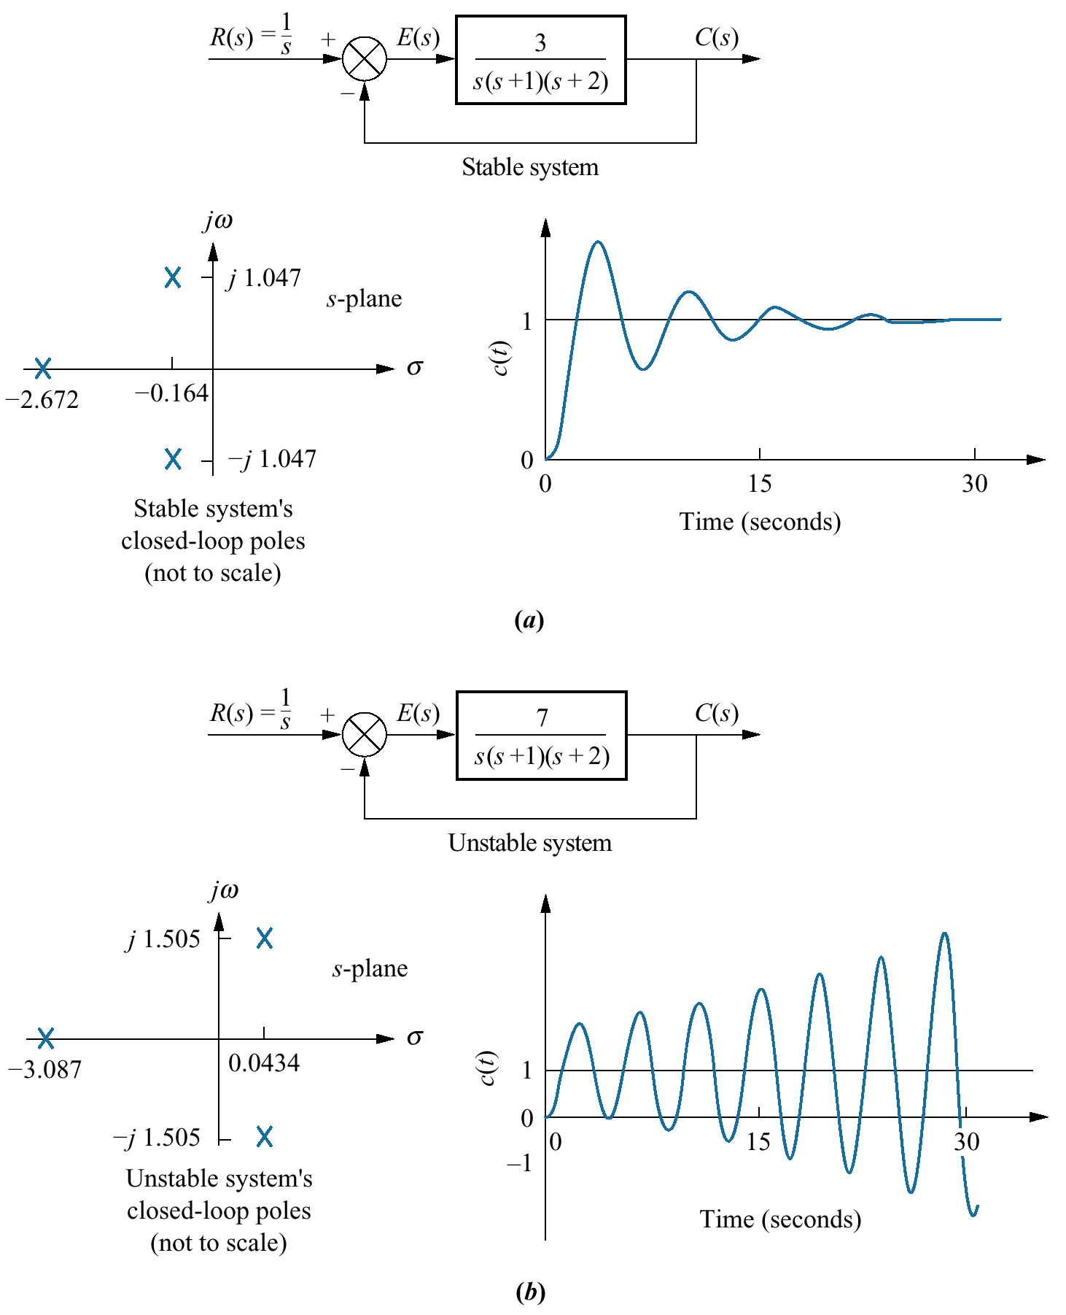

Slide 50
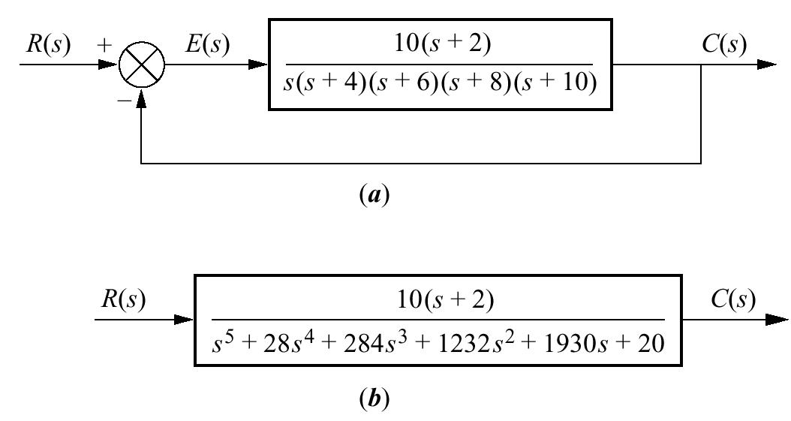
Cause of problems in finding closed-loop poles:
Poles for the forward TF are known
Closed-loop system
We need to factorize the characteristic polynomial to find roots of the closed-loop TF
equivalent system

Slide 51
Location of the poles of the closed-loop system are not known unless the characteristic polynomial is factored or otherwise solved for the roots.
Some conclusions can be drawn about the stability of the system.
If the transfer function has poles only in the left-half-plane, then the factors of the denominator consist of products of terms:
s + a_{i}
a_{i} is real and positive, or complex with a positive real part
The product of terms a_{i} is a polynomial with all positive coefficients
No term of the polynomial can be missing
(no cancellation between positive and negative coefficients in the factors)

Slide 52
A sufficient condition for a system to be unstable is that all signs of the coefficients of the denominator of the transfer function are not the same.
If powers of s are missing, the system is either unstable or marginally stable
If all coefficients of the denominator are positive and not missing, we are uncertain about the system's pole locations
How can we find about stability of the system if all coefficient are greater than zero ????

Slide 53

???

